Slide 1

Texas A&M University Recreation Center Floor-plan Webpage
By: Jenee Donley, Steven Dang Ma, Jenna Freed, Long Tien

Slide 2
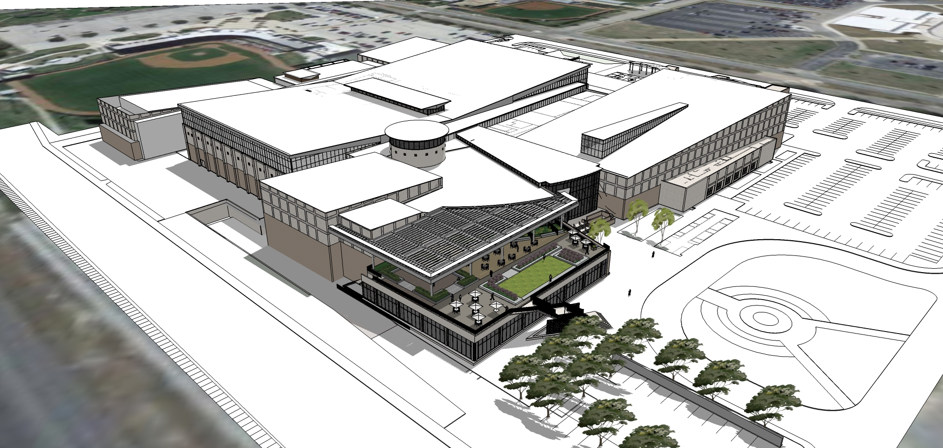
Project Goals
Construct a web page that shows the floors of the TAMU Student Rec Center individually
Provide room information for the most used rooms on each of the 3 floors
Style it appropriately using TAMU Brand guidelines

Slide 3
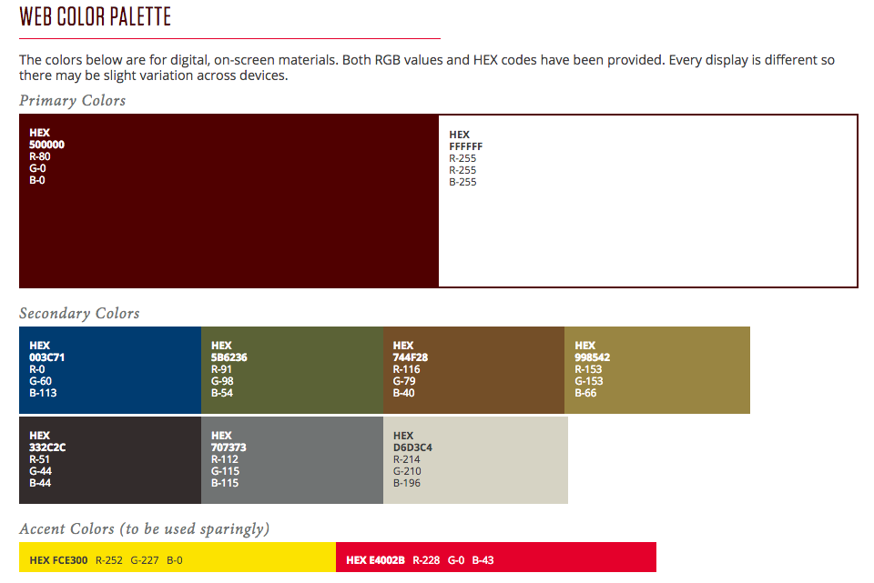
Approach
Attained CAD drawings
Create webpage that would host each floor plan individually
Label specific rooms for each floor plan and add pop-up boxes to include additional info on the rooms
Use CSS to make website presentable while following A&M Branding Policies

Slide 4
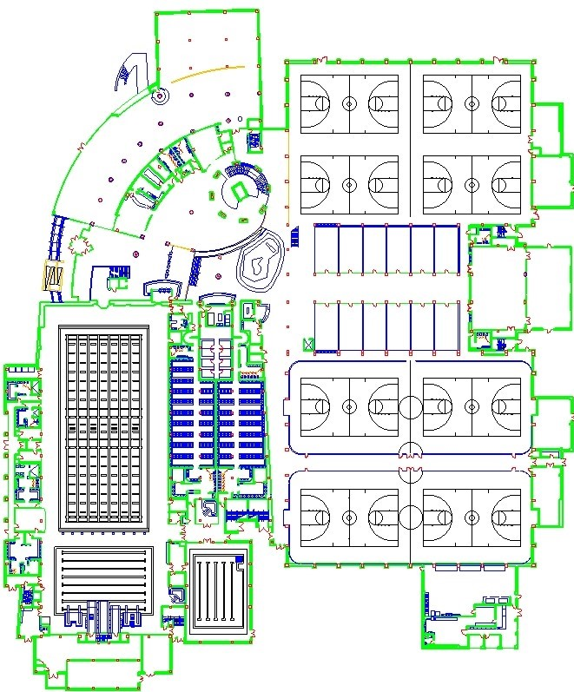
Challenges
Obtaining the updated floor-plans of the Rec Center
Using CSS to style the web page
Creating popups based off a specific pixel within the floor-plan image
Image resolution adjustments

Slide 5
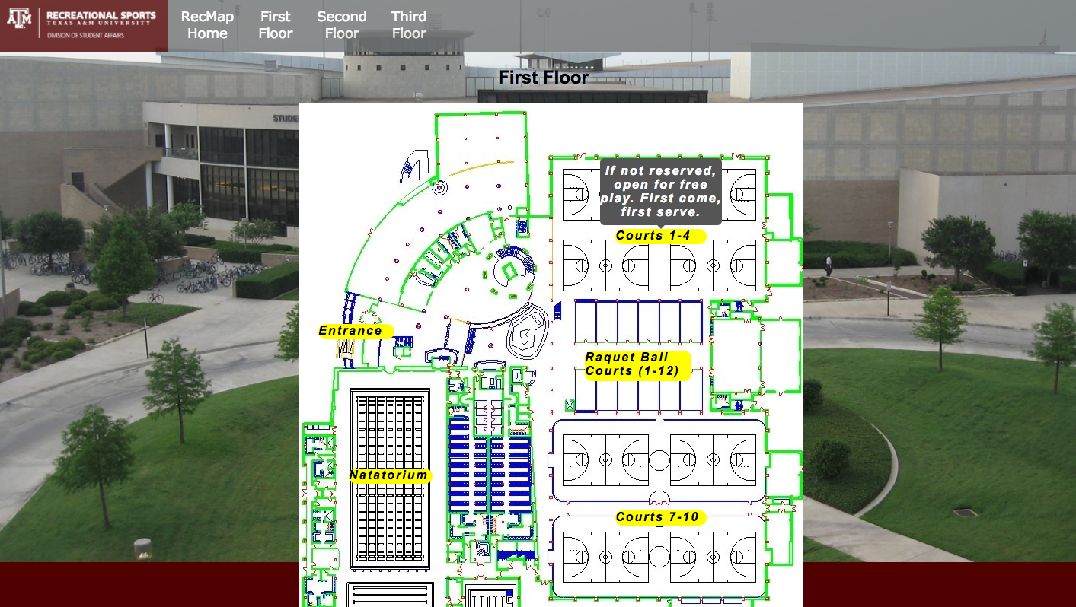
Working Demo/Screenshots

Slide 6
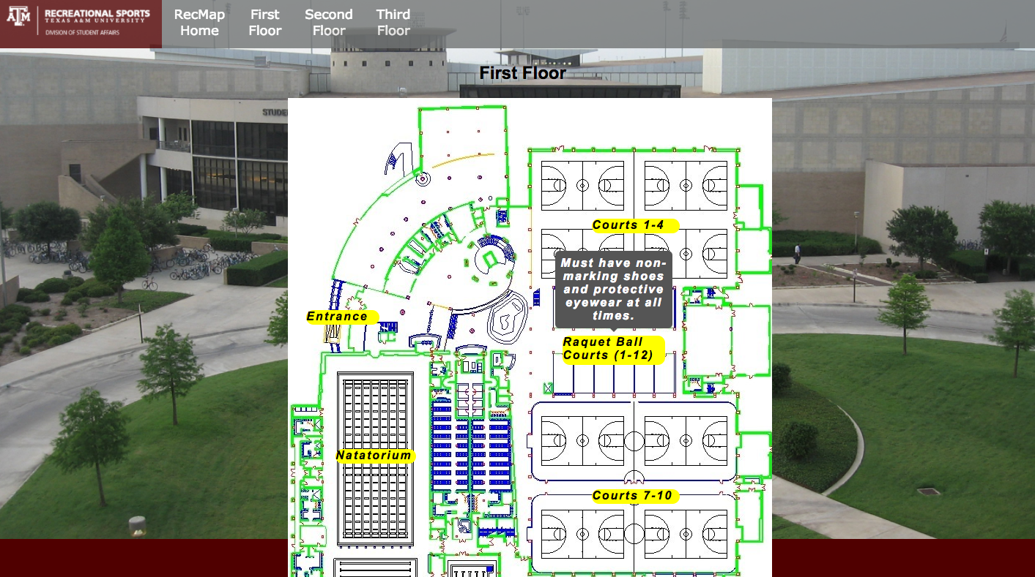
Working Demo/Screenshots

Slide 7
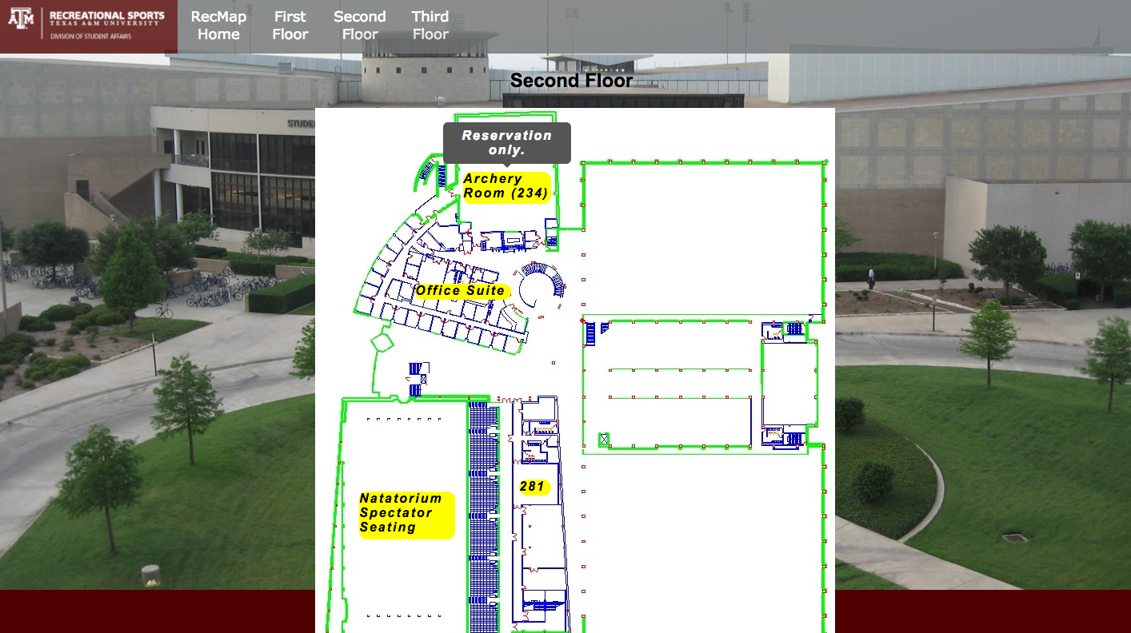
Working Demo/Screenshots

Slide 8
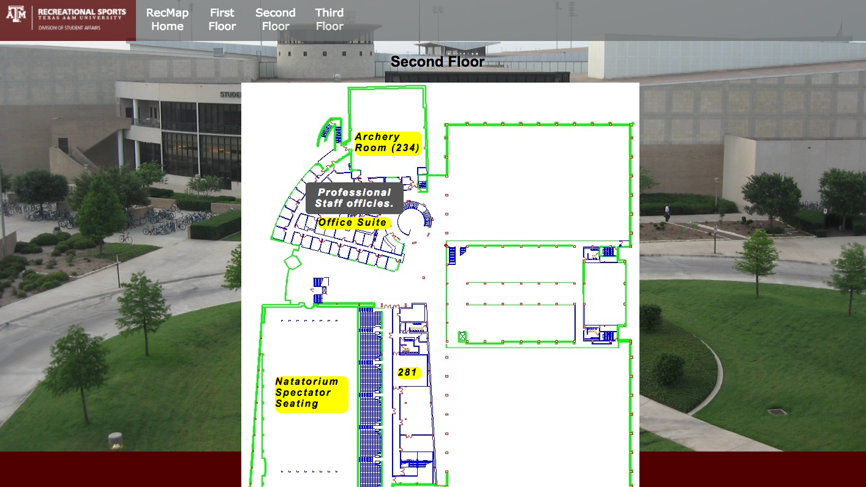
Working Demo/Screenshots

Slide 9
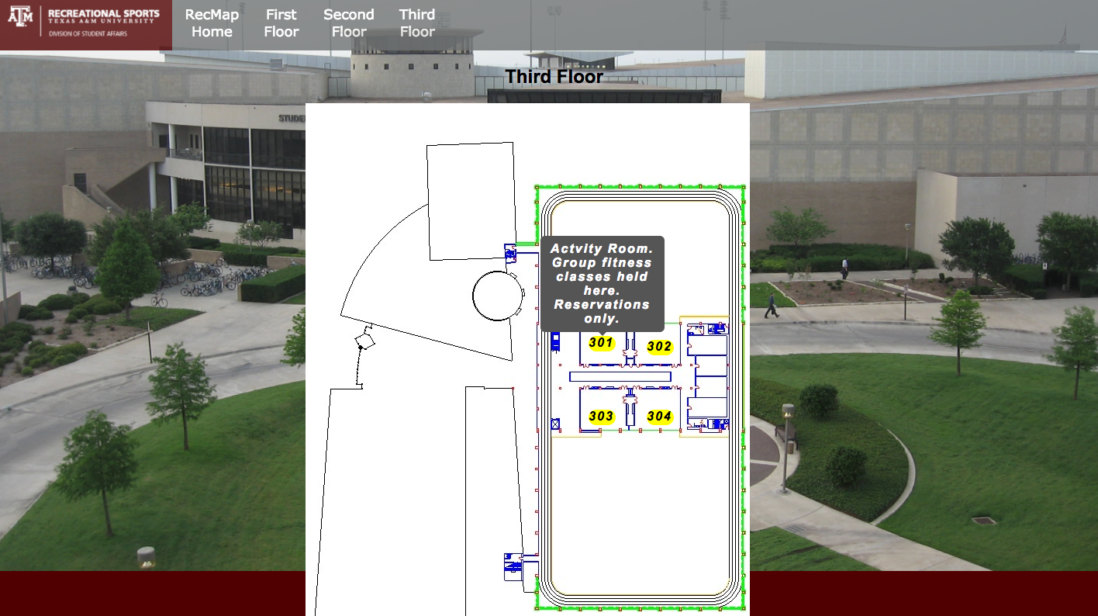
Working Demo/Screenshots

Slide 10
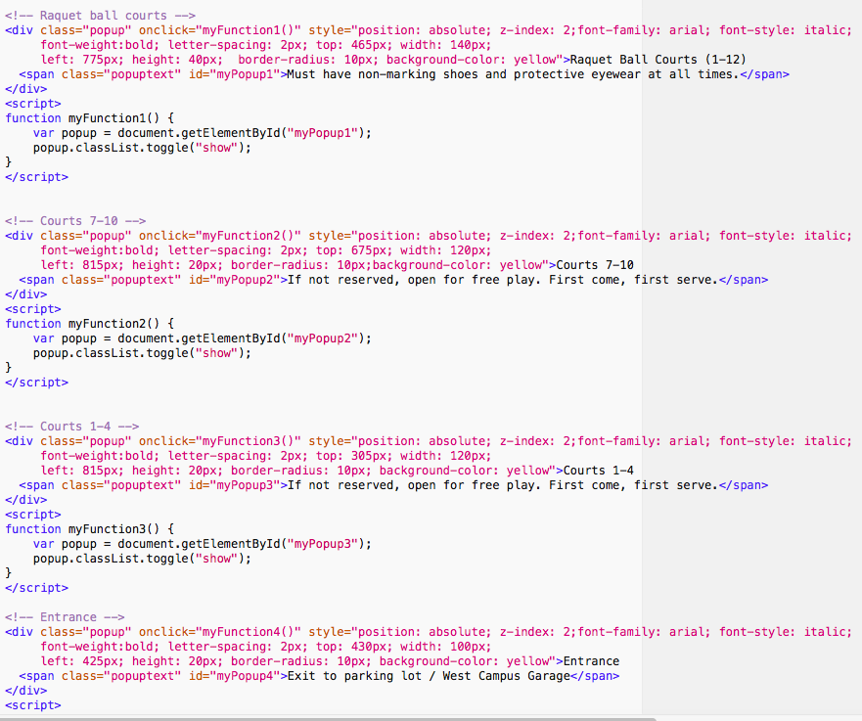
Code Examples

Slide 11
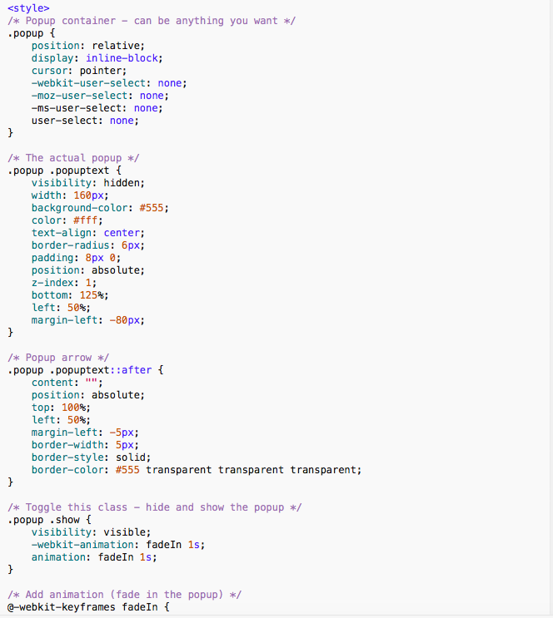
Code Examples

Slide 12
Customer Feedback
Customer was please with the progress and it’s user friendliness.
Will be giving him the files that we created.
Can’t be used publicly until most recent floorplans are obtained.

Slide 13
What now?
Client has team contact information. If he is able to provide more recent data we will be able to update the map.
We would then be able to collaborate with Rec Sports Media team to possibly integrate it into website.

Slide 14

Contact Info
Jenee Donley - jenee.donley@tamu.edu
Steven Dang Ma - sdangma@tamu.edu
Jenna Freed - freedj017@tamu.edu
Long Tien - l.t@tamu.edu

